Slide 1
程序设计原理
C++字符串
任课教师： 喻 梅
于瑞国
王建荣
李雪威
赵满坤

Slide 2
The C++ string Class
Special data type supports working with strings
#include <string>
Can define string variables in programs:
  string firstName, lastName;
Can receive values with assignment operator:
  firstName = "George";
  lastName = "Washington";
Can be displayed via cout
  cout << firstName << " " << lastName;

Slide 3
Input into a string Object
Use cin >> to read an item into a string:
  string firstName;
  cout << "Enter your first name: ";
  cin >> firstName;
Use getline function to put a line of input, possibly including spaces, into a string:
  string address;
  cout << "Enter your address: ";
  getline(cin,address);

Slide 4
string Comparison
Can use relational operators directly to compare string objects:
string str1 = "George",
str2 = "Georgia";
if (str1 < str2)
cout << str1 << " is less than "
<< str2;
Comparison is performed similar to strcmp function. Result is true or false

Slide 5
Assigning a String
You can use several overloaded functions to assign new contents to a string. For example, see the following code:
string s1("Welcome");
s1.assign("Dallas"); // assigns "Dallas" to s1
cout << s1 << endl; // s1 now becomes Dallas
string s2("Welcome");
s2.assign("Dallas, Texas", 0, 5); // assigns "Dalla" to s2
cout << s2 << endl; // s2 now becomes Dalla
string s3("Welcome");
s3.assign("Dallas, Texas", 5); // assigns "Dalla" to s3
cout << s3 << endl; // s3 now becomes Dalla
string s4("Welcome");
s4.assign(4, 'G'); // assigns "GGGG" to s4
cout << s4 << endl; // s4 now becomes GGGG

Slide 6
Appending a String
You can use several overloaded functions to add new contents to a string. For example, see the following code:
string s1("Welcome");
s1.append(" to C++"); // appends " to C++" to s1
cout << s1 << endl; // s1 now becomes Welcome to C++
string s2("Welcome");
s2.append(" to C and C++", 0, 5); // appends " to C" to s2
cout << s2 << endl; // s2 now becomes Welcome to C
string s3("Welcome");
s3.append(" to C and C++", 5); // appends " to C" to s3
cout << s3 << endl; // s3 now becomes Welcome to C
string s4("Welcome");
s4.append(4, 'G'); // appends "GGGG" to s4
cout << s4 << endl; // s4 now becomes WelcomeGGGG

Slide 7
Functions at, clear, erase, and empty
You can use the at(index) function to retrieve a character at a specified index, clear() to clear the string, erase(index, n) to delete part of the string, and empty() to test if a string is empty. For example, see the following code:
string s1("Welcome");
cout << s1.at(3) << endl; // s1.at(3) returns c
cout << s1.erase(2, 3) << endl; // s1 is now Weme
s1.clear(); // s1 is now empty
cout << s1.empty() << endl; // s1.empty returns 1 (means true)

Slide 8
Comparing Strings
Often, in a program, you need to compare the contents of two strings. You can use the compare function. This function works in the same way as the C-string strcmp function and returns a value greater than 0, 0, or less than 0. For example, see the following code:
string s1("Welcome");
string s2("Welcomg");
cout << s1.compare(s2) << endl; // returns -2
cout << s2.compare(s1) << endl; // returns 2
cout << s1.compare("Welcome") << endl; // returns 0

Slide 9
Obtaining Substrings
You can obtain a single character from a string using the at function. You can also obtain a substring from a string using the substr function. For example, see the following code:
string s1("Welcome");
cout << s1.substr(0, 1) << endl; // returns W
cout << s1.substr(3) << endl; // returns come
cout << s1.substr(3, 3) << endl; // returns com

Slide 10
Searching in a String
You can use the find function to search for a substring or a character in a string. For example, see the following code:
string s1("Welcome to HTML");
cout << s1.find("co") << endl; // returns 3
cout << s1.find("co", 6) << endl; // returns -1
cout << s1.find('o') << endl; // returns 4
cout << s1.find('o', 6) << endl; // returns 9

Slide 11
Inserting and Replacing Strings
Here are the examples to use the insert and replace functions:
string s1("Welcome to HTML");
s1.insert(11, "C++ and ");
cout << s1 << endl; // s1 becomes Welcome to C++ and HTML
string s2("AA");
s2.insert(1, 4, 'B');
cout << s2 << endl; // s2 becomes to ABBBBA
string s3("Welcome to HTML");
s3.replace(11, 4, "C++");
cout << s3 << endl; // returns Welcome to C++

Slide 12
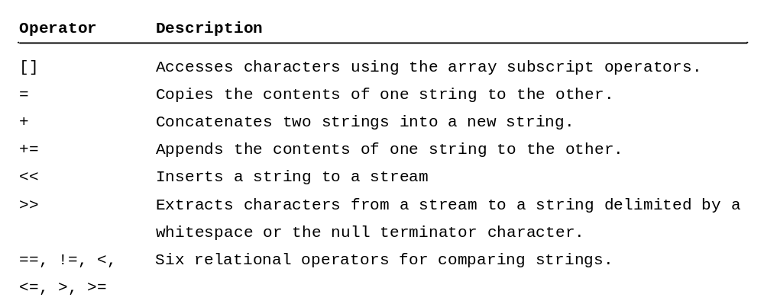
String Operators

Slide 13
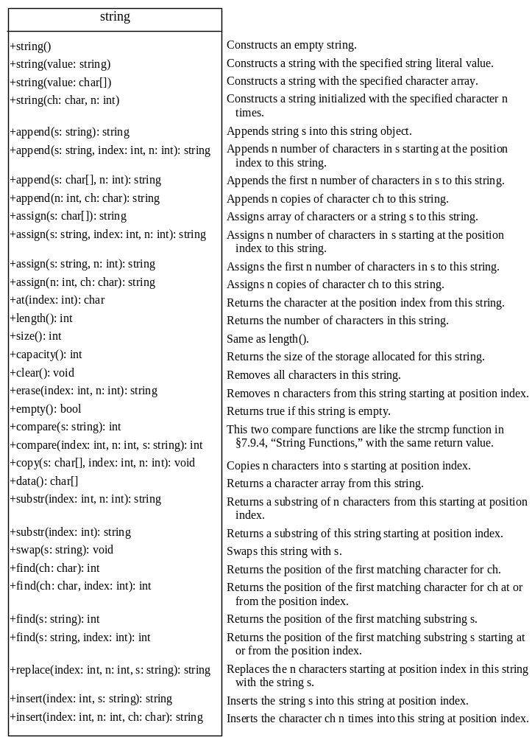

Slide 14
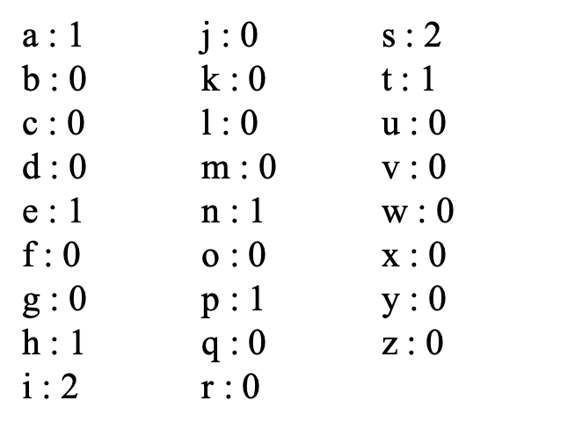
Exercise
Counting Characters
Write a program which counts and reports the number of each alphabetical letter. Ignore the case of characters.
Input
A sentence in English is given in several lines.
Output
Prints the number of alphabetical letters in the following format:
a : The number of 'a'
b : The number of 'b'
c : The number of 'c'
.
.
z : The number of 'z'
Constraints
The number of characters in the sentence < 1200
Sample Input
This is a pen.
Sample Output

Slide 15
Exercise
Toggling Cases
Write a program which converts uppercase/lowercase letters to lowercase/uppercase for a given string.
Input
A string is given in a line.
Output
Print the converted string in a line. Note that you do not need to convert any characters other than alphabetical letters.
Constraints
The length of the input string < 1200
Sample Input
fAIR, LATER, OCCASIONALLY CLOUDY.
Sample Output
Fair, later, occasionally cloudy.

Slide 16
Exercise
Card Game
Taro and Hanako are playing card games. They have n cards each, and they compete n turns. At each turn Taro and Hanako respectively puts out a card. The name of the animal consisting of alphabetical letters is written on each card, and the bigger one in lexicographical order becomes the winner of that turn. The winner obtains 3 points. In the case of a draw, they obtain 1 point each.
Write a program which reads a sequence of cards Taro and Hanako have and reports the final scores of the game.
Input
In the first line, the number of cards n is given. In the following n lines, the cards for n turns are given respectively. For each line, the first string represents the Taro's card and the second one represents Hanako's card.

Slide 17
Exercise
Constraints
n ≤ 1000
The length of the string ≤ 100
Output
Print the final scores of Taro and Hanako respectively. Put a single space character between them.
Sample Input
3
cat dog
fish fish
lion tiger
Sample Output
1 7

Slide 18

Exercise
Ring
Write a program which finds a pattern p
in a ring shaped text s.
Input
In the first line, the text s is given.
In the second line, the pattern pis given.
Output
If p is in s, print Yes in a line, otherwise No.
Constraints
1≤length of p≤ length of s≤100
s and p consists of lower-case letters
Sample Input 2
vanceknowledgetoad
advanced
Sample Output 2
No
Sample Input 1
vanceknowledgetoad
advance
Sample Output 1
Yes

Slide 19
Exercise
Finding a Word
Write a program which reads a word W and a text T, and prints the number of word W which appears in text T. T consists of string Ti separated by space characters and newlines. Count the number of Ti which equals to W. The word and text are case insensitive.
Constraints
The length of W ≤ 10
W consists of lower case letters
The length of T in a line ≤ 1000
Input
In the first line, the word W is given. In the following lines, the text T is given separated by space characters and newlines.
"END_OF_TEXT" indicates the end of the text.
Output
Print the number of W in the text.
Sample Input
computer
Nurtures computer scientists and highly-skilled computer engineers
who will create and exploit "knowledge" for the new era.
Provides an outstanding computer environment.
END_OF_TEXT
Sample Output
3

